Slide 1
Reinforcement Learning (RL)
Learning from rewards (and punishments)
Learning to assess the value of states.
Learning goal directed behavior.
RL has been developed rather independently from two different fields:
Dynamic Programming and Machine Learning (Bellman Equation).
Psychology (Classical Conditioning) and later Neuroscience (Dopamine System in the brain)

Slide 2
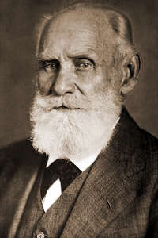
Back to Classical Conditioning
U(C)S = Unconditioned Stimulus
U(C)R = Unconditioned Response
CS = Conditioned Stimulus
CR = Conditioned Response
I. Pawlow

Slide 3
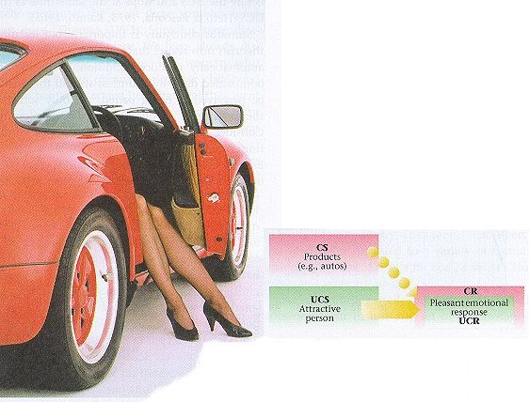
Less “classical” but also Conditioning !
(Example from a car advertisement)
Learning the association
CS → U(C)R
Porsche → Good Feeling

Slide 4
Why would we want to go back to CC at all??
So far: We had treated Temporal Sequence Learning in time-
continuous systems (ISO, ICO, etc.)
Now: We will treat this in time-discrete systems.
ISO/ICO so far did NOT allow us to learn:
GOAL DIRECTED BEHAVIOR
ISO/ICO performed:
DISTURBANCE COMPENSATION (Homeostasis Learning)
The new RL= formalism to be introduced now will indeed
allow us to reach a goal:
LEARNING BY EXPERIENCE TO REACH A GOAL

Slide 5
Overview over different methods – Reinforcement Learning
You are here !

Slide 6
Overview over different methods – Reinforcement Learning
And later also here !

Slide 7
Notation
US = r,R = “Reward” (similar to X₀ in ISO/ICO)
CS = s,u = Stimulus = “State¹” (similar to X₁ in ISO/ICO)
CR = v,V = (Strength of the) Expected Reward = “Value”
UR = --- (not required in mathematical formalisms of RL)
Weight = ω = weight used for calculating the value; e.g. v=ωu
Action = a = “Action”
Policy = π = “Policy”
“…” = Notation from Sutton & Barto 1998, red from S&B as well as from Dayan and Abbott.
¹ Note: The notion of a “state” really only makes sense as soon as there is more than one state.

Slide 8
A note on “Value” and “Reward Expectation”
If you are at a certain state then you would value this state according to how much reward you can expect when moving on from this state to the end-point of your trial.
Hence:
Value = Expected Reward !
More accurately:
Value = Expected cumulative future discounted reward.
(for this, see later!)

Slide 9
Types of Rules
Rescorla-Wagner Rule: Allows for explaining several types of conditioning experiments.
TD-rule (TD-algorithm) allows measuring the value of states and allows accumulating rewards. Thereby it generalizes the Resc.-Wagner rule.
TD-algorithm can be extended to allow measuring the value of actions and thereby control behavior either by ways of
Q or SARSA learning or with
Actor-Critic Architectures

Slide 10
Overview over different methods – Reinforcement Learning
You are here !

Slide 11
Rescorla-Wagner Rule
Pre-Train
Train
Result
Pavlovian:
Extinction:
Partial:
u→r
u→v=max
u→r
u→●
u→v=0
u→r u→●
u→v<max
We define: v = ωu, with u=1 or u=0, binary and
ω → ω + μδu with δ = r - v
The associability between stimulus u and reward r is represented by the learning rate μ.
This learning rule minimizes the avg. squared error between actual reward r and the prediction v, hence min<(r-v)²>
We realize that δ is the prediction error.

Slide 12
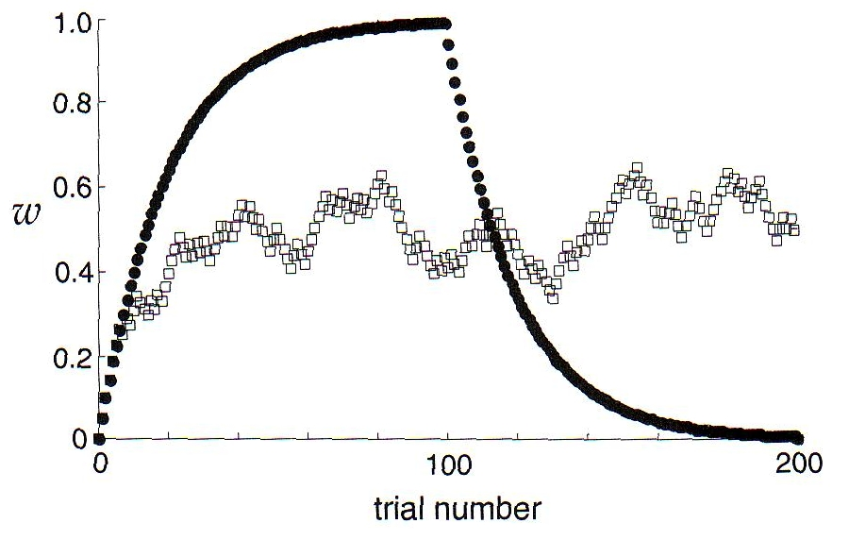
Pawlovian
Extinction
Partial
Stimulus u is paired with r=1 in 100% of the discrete “epochs” for Pawlovian
and in 50% of the cases for Partial.

Slide 13
Rescorla-Wagner Rule, Vector Form for Multiple Stimuli
We define: v = w.u, and
w → w + μδu with δ = r – v
Where we use stochastic gradient descent for minimizing δ
Do you see the similarity of this rule with the δ-rule discussed earlier !?
Pre-Train
Train
Result
Blocking:
u₁→r
u₁+u₂→r
u₁→v=max, u₂→v=0
For Blocking: The association formed during pre-training leads to δ=0. As ω₂ starts with zero the expected reward v=ω₁u₁+ω₂u₂ remains at r. This keeps δ=0 and the new association with u₂ cannot be learned.

Slide 14
Rescorla-Wagner Rule, Vector Form for Multiple Stimuli
Pre-Train
Train
Result
Inhibitory:
u₁+u₂→●, u₁→r
u₁→v=max, u₂→v<0
Inhibitory Conditioning: Presentation of one stimulus together with the reward and alternating presenting a pair of stimuli where the reward is missing. In this case the second stimulus actually predicts the ABSENCE of the reward (negative v).
Trials in which the first stimulus is presented together with the reward lead to ω₁>0.
In trials where both stimuli are present the net prediction will be v=ω₁u₁+ω₂u₂ = 0.
As u_{1,2}=1 (or zero) and ω₁>0, we get ω₂<0 and, consequentially, v(u₂)<0.

Slide 15
Rescorla-Wagner Rule, Vector Form for Multiple Stimuli
Pre-Train
Train
Result
Overshadow:
u₁+u₂→r
u₁→v<max, u₂→v<max
Overshadowing: Presenting always two stimuli together with the reward will lead to a “sharing” of the reward prediction between them. We get v= ω₁u₁+ω₂u₂ = r. Using different learning rates μ will lead to differently strong growth of ω_{1,2} and represents the often observed different saliency of the two stimuli.

Slide 16
Rescorla-Wagner Rule, Vector Form for Multiple Stimuli
Pre-Train
Train
Result
Secondary:
u₁→r
u₂→u₁
u₂→v=max
Secondary Conditioning reflect the “replacement” of one stimulus by a new one for the prediction of a reward.
As we have seen the Rescorla-Wagner Rule is very simple but still able to represent many of the basic findings of diverse conditioning experiments.
Secondary conditioning, however, CANNOT be captured.
(sidenote: The ISO/ICO rule can do this!)

Slide 17
Predicting Future Reward
The Rescorla-Wagner Rule cannot deal with the sequentiallity of stimuli (required to deal with Secondary Conditioning). As a consequence it treats this case similar to Inhibitory Conditioning lead to negative ω₂.
Animals can predict to some degree such sequences and form the correct associations. For this we need algorithms that keep track of time.
Here we do this by ways of states that are subsequently visited and evaluated.
Sidenote: ISO/ICO treat time in a fully continuous way, typical RL formalisms (which will come now) treat time in discrete steps.

Slide 18
Prediction and Control
The goal of RL is two-fold:
To predict the value of states (exploring the state space following a policy) – Prediction Problem.
Change the policy towards finding the optimal policy – Control Problem.
Terminology (again):
State,
Action,
Reward,
Value,
Policy

Slide 19
Markov Decision Problems (MDPs)
rewards
actions
states
If the future of the system depends always only on the current state and action then the system is said to be “Markovian”.

Slide 20
What does an RL-agent do ?
An RL-agent explores the state space trying to accumulate as much reward as possible. It follows a behavioral policy performing actions (which usually will lead the agent from one state to the next).
For the Prediction Problem: It updates the value of each given state by assessing how much future (!) reward can be obtained when moving onwards from this state (State Space). It does not change the policy, rather it evaluates it. (Policy Evaluation).

Slide 21
For the Control Problem: It updates the value of each given action at a given state and of by assessing how much future reward can be obtained when performing this action at that state (State-Action Space, which is larger than the State Space). and all following actions at the following state moving onwards.
Guess: Will we have to evaluate ALL states and actions onwards?

Slide 22
What does an RL-agent do ?
Exploration – Exploitation Dilemma: The agent wants to get as much cumulative reward (also often called return) as possible. For this it should always perform the most rewarding action “exploiting” its (learned) knowledge of the state space. This way it might however miss an action which leads (a bit further on) to a much more rewarding path. Hence the agent must also “explore” into unknown parts of the state space. The agent must, thus, balance its policy to include exploitation and exploration.
Policies
Greedy Policy: The agent always exploits and selects the most rewarding action. This is sub-optimal as the agent never finds better new paths.

Slide 23
Policies
ε-Greedy Policy: With a small probability ε the agent will choose a non-optimal action. *All non-optimal actions are chosen with equal probability.* This can take very long as it is not known how big ε should be. One can also “anneal” the system by gradually lowering ε to become more and more greedy.
Softmax Policy: ε-greedy can be problematic because of (*). Softmax ranks the actions according to their values and chooses roughly following the ranking using for example:
where Q_{a} is value of the currently to be evaluated action a and T is a temperature parameter. For large T all actions have approx. equal probability to get selected.

Slide 24
Overview over different methods – Reinforcement Learning
You are here !

Slide 25
Towards TD-learning – Pictorial View
In the following slides we will treat “Policy evaluation”: We define some given policy and want to evaluate the state space. We are at the moment still not interested in evaluating actions or in improving policies.
Back to the question: To get the value of a given state, will we have to evaluate ALL states and actions onwards?
There is no unique answer to this! Different methods exist which assign the value of a state by using differently many (weighted) values of subsequent states. We will discuss a few but concentrate on the most commonly used TD-algorithm(s).
Temporal Difference (TD) Learning

Slide 26
Lets, for example, evaluate just state 4:
Tree backup methods:
Most simplistically and very slow: Exhaustive Search: Update of state 4 takes all direct target states and all secondary, ternary, etc. states into account until reaching the terminal states and weights all of them with their corresponding action probabilities.
Mostly of historical and theoretical relevance: Dynamic Programming: Update of state 4 takes all direct target states (9,10,11) into account and weights their rewards with the probabilities of their triggering actions p(a5), p(a7), p(a9).

Slide 27
Linear backup methods
Full linear backup: Monte Carlo [= TD(1)]: Sequence C (4,10,13,15): Update of state 4 (and 10 and 13) can commence as soon as terminal state 15 is reached.

Slide 28
Linear backup methods
Single step linear backup: TD(0): Sequence A: (4,10) Update of state 4 can commence as soon as state 10 is reached. This is the most important algorithm.

Slide 29
Linear backup methods
Weighted linear backup: TD(λ): Sequences A, B, C: Update of state 4 uses a weighted average of all linear sequences
until terminal state 15.

Slide 30
Why are we calling these methods “backups” ? Because we move to one or more next states, take their rewards&values, and then move back to the state which we would like to update and do so!
For the following:
Note: RL has been developed largely in the context of machine learning. Hence all mathematically rigorous formalisms for RL comes from this field.
A rigorous transfer to neuronal model is a more recent development.
Thus, in the following we will use the machine learning formalism to derive the math and in parts relate this to neuronal models later.
This difference is visible from using
STATES s_{t} for the machine learning formalism and
TIME t when talking about neurons.

Slide 31
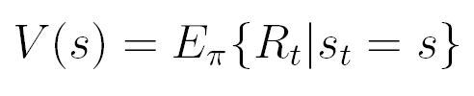
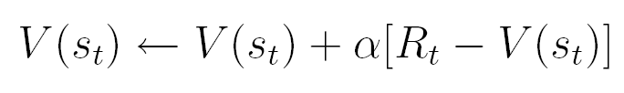
Formalising RL: Policy Evaluation with goal to find the optimal value function of the state space
We consider a sequence s_{t}, r_{t+1}, s_{t+1}, r_{t+2}, . . . , r_{T} , s_{T} . Note, rewards occur downstream (in the future) from a visited state. Thus, r_{t+1} is the next future reward which can be reached starting from state s_{t}. The complete return R_{t} to be expected in the future from state s_{t} is, thus, given by:
where γ≤1 is a discount factor. This accounts for the fact that rewards in the far future should be valued less.
Reinforcement learning assumes that the value of a state V(s) is directly equivalent to the expected return E_{π} at this state, where π denotes the (here unspecified) action policy to be followed.
Thus, the value of state s_{t} can be iteratively updated with:

Slide 32

We use α as a step-size parameter, which is not of great importance here, though, and can be held constant.
Note, if V(s_{t}) correctly predicts the expected complete return R_{t}, the update will be zero and we have found the final value. This method is called constant-α Monte Carlo update. It requires to wait until a sequence has reached its terminal state (see some slides before!) before the update can commence. For long sequences this may be problematic. Thus, one should try to use an incremental procedure instead. We define a different update rule with:
The elegant trick is to assume that, if the process converges, the value of the next state V(s_{t+1}) should be an accurate estimate of the expected return downstream to this state (i.e., downstream to s_{t+1}). Thus, we would hope that the following holds:
This is why it is called TD (temp. diff.) Learning
Indeed, proofs exist that under certain boundary conditions this procedure, known as TD(0), converges to the optimal value function for all states.

Slide 33
In principle the same procedure can be applied all the way downstream writing:
Thus, we could update the value of state s_{t} by moving downstream to some future state s_{t+n−1} accumulating all rewards along the way including the last future reward r_{t+n} and then approximating the missing bit until the terminal state by the estimated value of state s_{t+n} given as V(s_{t+n}). Furthermore, we can even take different such update rules and average their results in the following way:
where 0≤λ≤1. This is the most general formalism for a TD-rule known as forward TD(λ)-algorithm, where we assume an infinitely long sequence.

Slide 34
Linear backup methods
Weighted linear backup: TD(λ): Sequences A, B, C: Update of state 4 uses a weighted average of all linear sequences
until terminal state 15.

Slide 35
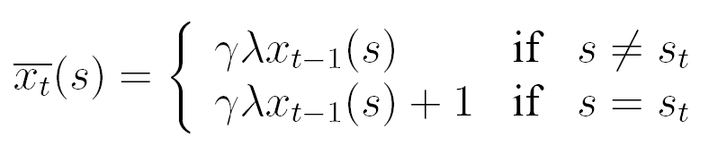
The disadvantage of this formalism is still that, for all λ > 0, we have to wait until we have reached the terminal state until update of the value of state s_{t} can commence.
There is a way to overcome this problem by introducing eligibility traces (Compare to ISO/ICO before!).
Let us assume that we came from state A and now we are currently visiting state B. B’s value can be updated by the TD(0) rule after we have moved on by only a single step to, say, state C. We define the incremental update as before as:
Normally we would only assign a new value to state B by performing
V(s_{B}) ← V(s_{B}) + αδ_{B}, not considering any other previously visited states. In using eligibility traces we do something different and assign new values to all previously visited states, making sure that changes at states long in the past are much smaller than those at states visited just recently. To this end we define the eligibility trace of a state as:
Thus, the eligibility trace of the currently visited state is incremented by one, while the eligibility
traces of all other states decay with a factor of γλ.

Slide 36

Instead of just updating the most recently left state s_{t} we will now loop through all states visited in the past of this trial which still have an eligibility trace larger than zero and update them according to:
In our example we will, thus, also update the value of state A by
V(s_{A}) ← V(s_{A})+ αδ_{B} x_{B}(A). This means we are using the TD-error δ_{B} from the state transition B → C weight it with the currently existing numerical value of the eligibility trace of state A given by x_{B}(A) and use this to correct the value of state A “a little bit”. This procedure requires always only a single newly computed TD-error using the computationally very cheap TD(0)-rule, and all updates can be performed on-line when moving through the state space without having to wait for the terminal state. The whole procedure is known as backward TD(λ)-algorithm and it can be shown that it is mathematically equivalent to forward TD(λ) described above.
Rigorous proofs exist the TD-learning will always find the optimal value function (can be slow, though).

Slide 37
TD(0) on a 9x9 grid
Asymptotic convergence of one weight.
Learning Rate 0.004
Learning Rate 0.4
Learning Rate 0.4
and dropping over time.

Slide 38
Reinforcement Learning – Relations to Brain Function I
You are here !

Slide 39
How to implement TD in a Neuronal Way
Now we have:
We had defined:
(first lecture!)
Trace
u₁

Slide 40
How to implement TD in a Neuronal Way
v(t+1)-v(t)
Note: v(t+1)-v(t) is acausal (future!). Make it “causal” by using delays.
Serial-Compound representations X₁,…X_{n} for defining an eligibility trace.

Slide 41
How does this implementation behave: w_{i} ← w_{i} + μδx_{i}
Forward shift because of acausal derivative

Slide 42
Observations
δ-error moves forward from the US to the CS.
The reward expectation signal extends forward to the CS.

Slide 43
Reinforcement Learning – Relations to Brain Function II
You are here !

Slide 44
TD-learning & Brain Function
This neuron is supposed to represent the δ-error of TD-learning, which has moved forward as expected.
DA-responses in the basal ganglia pars compacta of the
substantia nigra and the medially adjoining ventral tegmental area (VTA).
Omission of reward leads to inhibition as also predicted by the TD-rule.

Slide 45
TD-learning & Brain Function
This is even better visible from the population response of 68 striatal neurons
This neuron is supposed to represent the reward expectation signal v. It has extended forward (almost) to the CS (here called Tr) as expected from the TD-rule. Such neurons are found in the striatum, orbitofrontal cortex and amygdala.

Slide 46
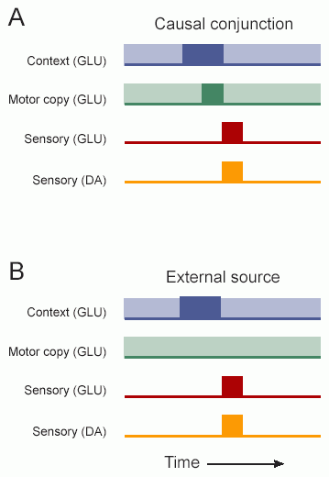
TD-learning & Brain Function Deficiencies
There are short-latency Dopamine responses! These signals could pro-mote the discovery of agency (i.e. those ini-tially unpredicted events that are caused by the agent) and subsequent identification of critical causative actions to re-select components of behavior and context that immediately pre-cede unpredicted sensory events. When the animal/agent is the cause of an event, re-peated trials should en-able the basal ganglia to converge on behavioral and contextual compo-nents that are critical for eliciting it, leading to the emergence of a novel action.
DA Signal leads to the learning of
this self-triggered association!
Incompatible to a serial compound representation of the stimulus as the δ-error should move step by step forward, which is not found. Rather it shrinks at r and grows at the CS.
=cause-effect

Slide 47
Reinforcement Learning – The Control Problem
So far we have concentrated on evaluating an unchanging policy. Now comes the question of how to actually improve a policy π trying to find the optimal policy.
We will discuss:
Actor-Critic Architectures
SARSA Learning
Q-Learning
Abbreviation for policy: π

Slide 48
Reinforcement Learning – Control Problem I
You are here !

Slide 49
Control Loops
Bump
Retraction
reflex
An old slide from some lectures earlier!
Any recollections?
☺ ?
This is a closed-loop
system before learning
The Basic Control Structure
Schematic diagram of
A pure reflex loop

Slide 50
Control Loops
A basic feedback–loop controller (Reflex) as in the slide before.

Slide 51
Control Loops
An Actor-Critic Architecture: The Critic produces evaluative, reinforcement feedback for the Actor by observing the consequences of its actions. The Critic takes the form of a TD-error which gives an indication if things have gone better or worse than expected with the preceding action. Thus, this TD-error can be used to evaluate the preceding action: If the error is positive the tendency to select this action should be strengthened or else, lessened.

Slide 52
Example of an Actor-Critic Procedure
Action selection here follows the Gibb’s Softmax method:
where p(s,a) are the values of the modifiable (by the Critic!) policy parameters of the actor, indicating the tendency to select action a when being in state s.
We can now modify p for a given state action pair at time t with:
where δ_{t} is the δ-error of the TD-Critic.

Slide 53
Reinforcement Learning – Control I & Brain Function III
You are here !

Slide 54
Actor-Critics and the Basal Ganglia
The basal ganglia are a brain structure involved in motor control. It has been suggested that they learn by ways of an Actor-Critic mechanism.
VP=ventral pallidum,
SNr=substantia nigra pars reticulata,
SNc=substantia nigra pars compacta,
GPi=globus pallidus pars interna,
GPe=globus pallidus pars externa,
VTA=ventral tegmental area,
RRA=retrorubral area, STN=subthalamic nucleus.

Slide 55
Actor-Critics and the Basal Ganglia: The Critic
DA
C
Cortex=C, striatum=S, STN=subthalamic Nucleus, DA=dopamine system, r=reward.
So called striosomal modules fulfil the functions of the adaptive Critic. The prediction-error (δ) characteristics of the DA-neurons of the Critic are generated by: 1) Equating the reward r with excitatory input from the lateral hypothalamus. 2) Equating the term v(t) with indirect excitation at the DA-neurons which is initiated from striatal striosomes and channelled through the subthalamic nucleus onto the DA neurons. 3) Equating the term v(t−1) with direct, long-lasting inhibition from striatal striosomes onto the DA-neurons. There are many problems with this simplistic view though: timing, mismatch to anatomy, etc.

Slide 56
Reinforcement Learning – Control Problem II
You are here !

Slide 57
SARSA-Learning
It is also possible to directly evaluate actions by assigning “Value” (Q-values and not V-values!) to state-action pairs and not just to states.
Interestingly one can use exactly the same mathematical formalism and write:
]
The Q-value of state-action pair s_{t},a_{t} will be updated using the reward at the next state and the Q-value of the next used state-action pair s_{t+1},a_{t+1}.
SARSA = state-action-reward-state-action
On-policy update!

Slide 58
Q-Learning
Note the difference! Called off-policy update.
Even if the agent will not go to the ‘blue’ state but to the ‘black’ one, it will nonethe-less use the ‘blue’ Q-value for update of the ‘red’ state-action pair.

Slide 59
Notes:
For SARSA and Q-learning rigorous proofs exist that they will always converge to the optimal policy.
Q-learning is the most widely used method for policy optimization.
For regular state-action spaces in a fully Markovian system Q-learning converges faster than SARSA.
Regular state-action spaces: States tile the state space in a non-overlapping way. System is fully deterministic (Hence rewards and values are associated to state-action pairs in a deterministic way.). Actions cover the space fully.
Note: In real world applications (e.g. robotics) there are many RL-systems, which are not regular and not fully Markovian.

Slide 60
Problems of RL
Curse of Dimensionality
In real world problems ist difficult/impossible to define discrete state-action spaces.
(Temporal) Credit Assignment Problem
RL cannot handle large state action spaces as the reward gets too much dilited along the way.
Partial Observability Problem
In a real-world scenario an RL-agent will often not know exactly in what state it will end up after performing an action. Furthermore states must be history independent.
State-Action Space Tiling
Deciding about the actual state- and action-space tiling is difficult as it is often critical for the convergence of RL-methods. Alternatively one could employ a continuous version of RL, but these methods are equally difficult to handle.
Non-Stationary Environments
As for other learning methods, RL will only work quasi stationary environments.

Slide 61
Problems of RL
Credit Structuring Problem
One also needs to decide about the reward-structure, which will affect the learning. Several possible strategies exist:
external evaluative feedback: The designer of the RL-system places rewards and punishments by hand. This strategy generally works only in very limited scenarios because it essentially requires detailed knowledge about the RL-agent's world.
internal evaluative feedback: Here the RL-agent will be equipped with sensors that can measure physical aspects of the world (as opposed to 'measuring' numerical rewards). The designer then only decides, which of these physical influences are rewarding and which not.
Exploration-Exploitation Dilemma
RL-agents need to explore their environment in order to assess its reward structure. After some exploration the agent might have found a set of apparently rewarding actions. However, how can the agent be sure that the found actions where actually the best? Hence, when should an agent continue to explore or else, when should it just exploit its existing knowledge? Mostly heuristic strategies are employed for example annealing-like procedures, where the naive agent starts with exploration and its exploration-drive gradually diminishes over time, turning it more towards exploitation.

Slide 62
(Action -)Value Function Approximation
In order to reduce the temporal credit assignment problem methods have been devised to approximate the value function using so-called features to define an augmented state-action space.
Most commonly one can use large, overlapping features (like “receptive fields”) and thereby coarse-grain the state space.
Black: Regular non-overlapping state space (here 100 states).
Red: Value function approximation using here 17 features, only.
Note: Rigorous convergence proof do in general not anymore exist for Function Approximation systems.

Slide 63
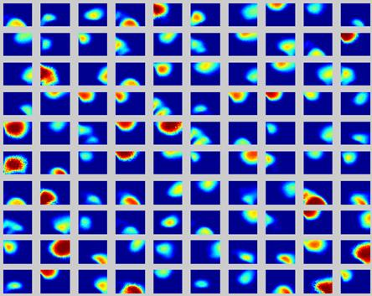
An Example: Path-finding in simulated rats
Goal: A simulated rat should find a reward in an arena.
This is a non-regular RL-system, because
Rats prefer straight runs (hence states are often “jumped-over” by the simulated rat). Actions do not cover the state space fully.
Rats (probably) use their hippocampal Place-Fields to learn such task. These place fields have different sizes and cover the space in an overlapping way. Furthermore, they fire to some degree stochastically.
Hence they represent an Action Value Function Approximation system.
Place field activity in an areana

Slide 64
Place field system
Path generation and Learning
Real (left) and generated (right) path examples.

Slide 65

Equations used for Function Approximation
We use SARSA as Q-learning is know to be more divergent in systems with function approximation:
For function approximation, we define normalized Q-values by:
where Φ_{i}(s_{t}) are the features over the state space, and θ_{i,at} are the adaptable weights binding features to actions.
We assume that a place cell i produces spikes with a scaled Gaussian-shaped probability distribution:
where δ_{i} is the distance from the i-th place field centre to the sample point (x,y) on the rat’s trajectory, σ defines the width of the place field, and A is a scaling factor.

Slide 66
We then use the actual place field spiking to determine the values for features Φ_{i}, i = 1, .., n, which take the value of 1, if place cell i spikes at the given moment on the given point of the trajectory of the model animal, otherwise it is zero:
SARSA learning then can be described by:
Where θ_{i,at} is the weight from the i-th place cell to action(-cell) a, and state s_{t} is defined by (x_{t},y_{t}), which are the actual coordinates of the model animal in the field.

Slide 67
Results
With
Without
Function Approximation
With function approximation one obtains much faster convergence.
However, this system does not always converge anymore.
Divergent run

Slide 68
RL versus CL
Reinforcement learning and correlation based (hebbian) learning in comparison:
RL:
Evaluative Feedback (rewards)
Network emulation (TD-rule, basal ganglia)
Goal directed action learning possible.
CL:
Non-evaluative Feedback (correlations only)
Single cell emulation ([diff.] Hebb rule, STDP)
Only homestasis action learning possible (?)
It can be proved that Hebbian learning which uses a third factor (Dopamine, e.g ISO3-rule) can be used to emulate RL (more specifically: the TD-rule) in a fully equivalent way.

Slide 69
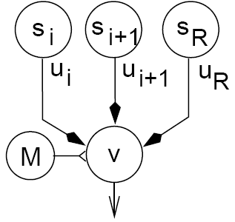
Neural-SARSA (n-SARSA)
ω_{i}
ω_{i+1}
When using an appropriate timing of the third factor M and “humps” for the u-functions one gets exactly the TD values at ω_{i}
ω_{r}
This shows the convergence result of a 25-state neuronal implementation using this rule.

